Slide 1
Helium Platform Assembly
Helium Training
Helium 22.04

Slide 2
Introduction
Helium Platform Assembly – part of Helium Virtual and Hybrid Studio – is a powerful, GUI-based solution for creating virtual and hybrid platforms that are correct by construction.
With Platform Assembly you can take the building blocks of platforms – your own models of IP, models and platforms from the Helium Model Catalog, natively integrated ARM Fast Models processors and peripherals, hybrid adapters and models such as Smart Memory – and assemble them into platforms either by starting with a reference platform that is close to your desired design and modifying it, or by building the platform up directly from building blocks.

Slide 3
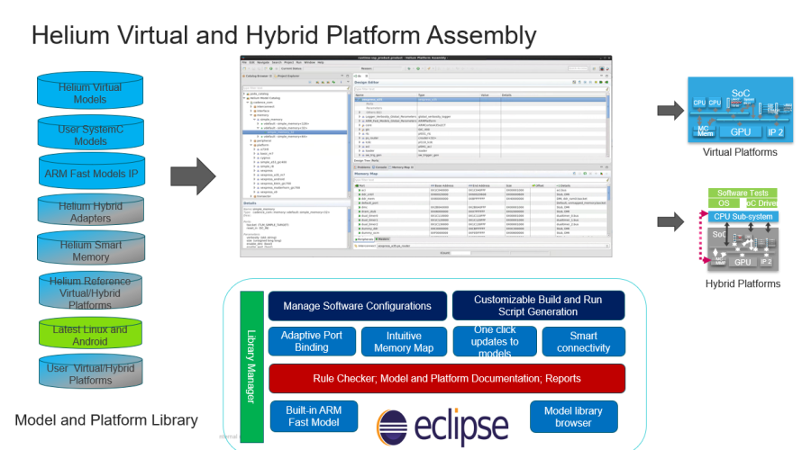

Slide 4
Helium Features
Model & Platform Management
Platform Editor
Browse and organize models, platforms and reference examples using Catalog Browser
One-click access to ARM Fast models
Ready-to-use repository of commonly used models comes pre-installed
Add User catalogs. Import Compiled SystemC Model into user Catalogs
Open & run examples shipped with Helium Model Catalog which also serve as starting points
Platform Lifecycle management : Refresh and Update flows for Arm Fast Models, catalogs, and tool version updates
Intelligent Port Binding : Design Check built on SystemC standards. Only valid connections suggested
Adaptive-Port-Binding introduces signals, bus-width converters as necessary
Vector-to-Vector binding lets users bind vectors of ports with a single click
One-click replacement of instance models
Correct by construction features : Memory Map Checks, Platform Checks, Platform Reports
HELIUM
Run & Debug
Memory Map Editor
Full fledged interactive software debugger
SW debugger is Linux kernel and module aware
Multiple run and debug configurations
Scriptable SW debugger
System Memory Map presented in an easy-to-understand view
Automatic entry creation and connections

Slide 5
Getting Started With Helium

Slide 6
Helium Tool Matrix
Helium requires the following tools
XCELIUM
ARM Fast Models
MMP (for DDR Smart Memory)
VXE (for Palladium Z1)
WXE (for Palladium Z2)
PTM (for Protium)
IXCOM (for Palladium or Protium)
HDLICE (for Palladium or Protium)
PDAPP (for Palladium or Protium)
Refer to the Helium Release Information document for the versions of these tools that are compatible with your version of Helium

Slide 7
Useful Documents To Get Started With Helium
See the Helium Virtual and Hybrid Studio Quick Start Guide document to see how to:
Prepare your environment and launch Helium
Use the Model Catalog
Use ARM Fast Models in your platforms
Use the Helium Platform Assembly Perspective
Debug your SystemC models
Use the Helium Embedded Software Debugger
Make Gearshift platforms
See the Helium Virtual and Hybrid Studio User Guide document for full details of Helium usage
See the Helium Model Catalog User Guide details of the models and platforms shipped with Helium

Slide 8
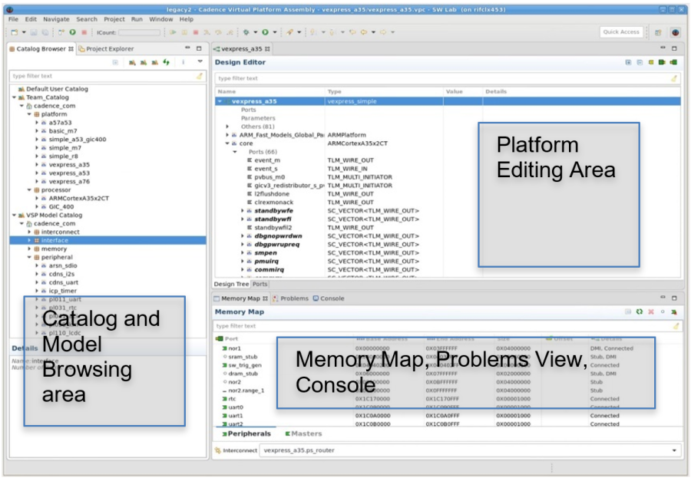
Platform Assembly Perspective

Slide 9
Organize and Explore Catalogs of Models and IP
Models & Platform Management

Slide 10
Organize and Explore Catalogs of Models and IP
Model & Platform Management
Platform Editor
Memory Map Editor
Run & Debug
Platforms Assembly makes it easy to browse and inspect the interfaces of models and subsystems from the Helium Model Catalog, ARM Fast Models and other 3rd Party models, user catalogs of SystemC models, and user-created SystemC-based models
The Helium Platform Assembly Catalog Browser View is the place to gather together and explore models used to build platforms
Working with ARM Fast Models in Helium
Preparing your SystemC Models, Legacy Platforms, and Catalog for Helium
Adding SystemC/TLM2 Models created with tlmgen or created from scratch
Adding existing catalogs of models

Slide 11
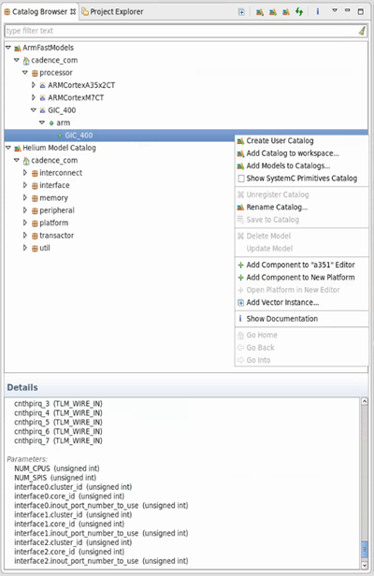
Using the Catalog Browser
Model & Platform Management
Platform Editor
Memory Map Editor
Run & Debug
Quickly Filter for Specific Model
User Catalog of ARM Fast Models
Helium makes it easy to gather all of your models into one convenient place for assembling platforms
Work with models provided by Cadence, your own SystemC models of IPs, and 3rd Party models such as Arm Fast Models in a single environment
Browse model interfaces and view documentation
Models organized into Vendor/Library/Name/Version Hierarchy (VLNV)
Create new empty catalog for adding models
Check to browse SystemC types such as signals
Open window that shows model documentation (html, pdf, etc)
Model Interface Information such as Ports and Parameters

Slide 12
Helium Models And Platforms Library
Model & Platform Management
Platform Editor
Memory Map Editor
Run & Debug
SystemC Virtual Models
Key virtual models
New Models e.g. PCIe, USB, UFS 3.0 coming soon
Natively Integrated ARM Fast Model Portfolio
Reference and Starter Base Platforms (Virtual and Hybrid)
Booting Linux and Android
ARM V8 and V9 cores based Reference Platforms
Latest Linux and Android versions
Hybrid Adapter Library, Smart Memory
Enables compatible drop in replacement of RTL components e.g. CPU, GIC
Bridges Virtual/TLM transactions with the RTL protocol
Bridges TLM signals to RTL

Slide 13
Running Helium Example platforms
Models & Platform Management

Slide 14
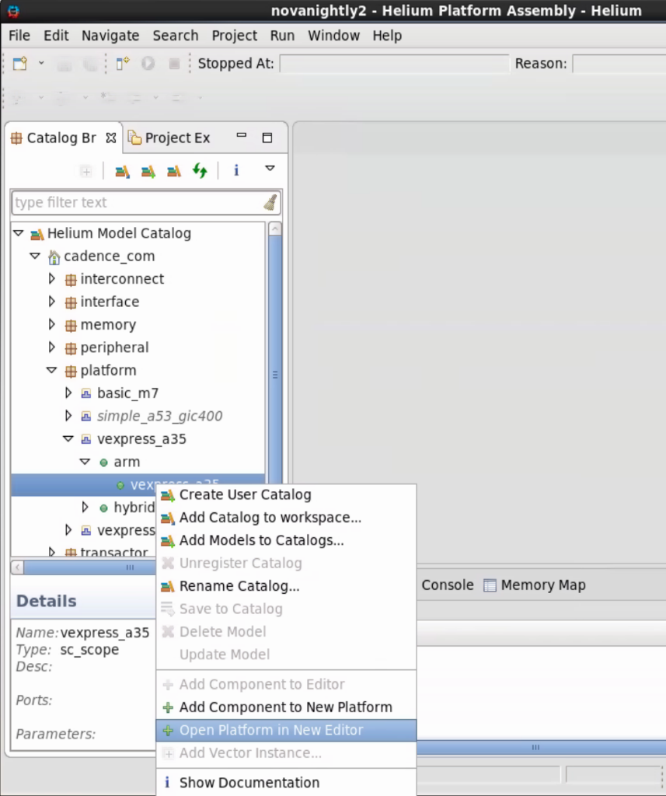
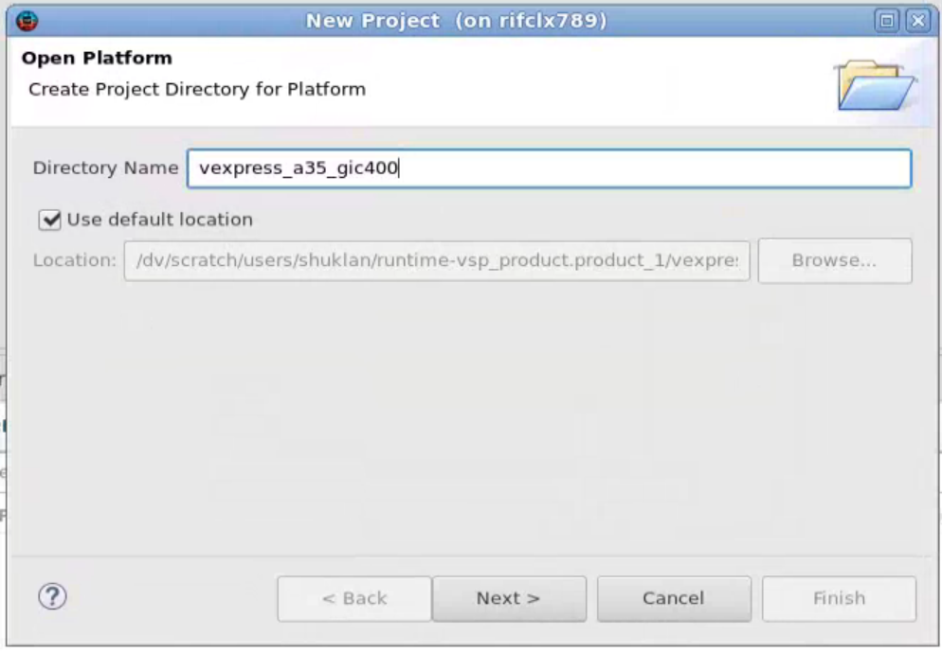
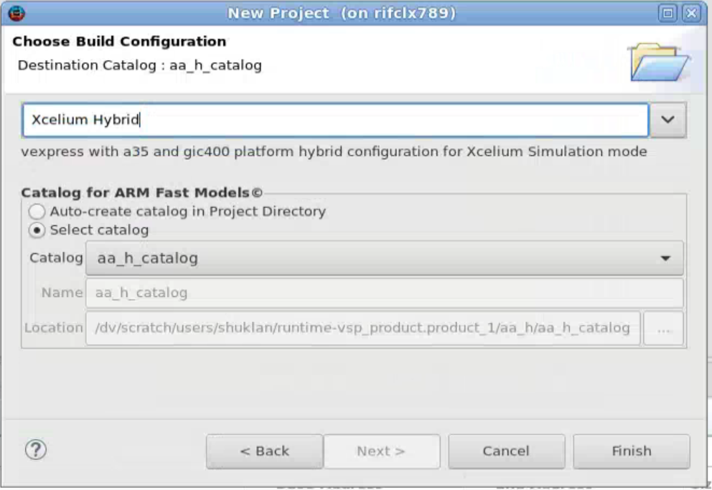
Working with a Helium Example Platform
Model & Platform Management
Platform Editor
Memory Map Editor
Run & Debug
Helium Example platforms
Helium reference and starter platforms provide a starting point for creating new platforms and also serve as reference examples for using powerful Helium features
Start by choosing from a robust collection of Helium reference and starter platforms (virtual and hybrid) that most closely fits the desired processor/GIC/OS combination
Helium reference platforms can also be instantiated as subsystems to build up complex platforms
See vexpress_a35_m7 example

Slide 15
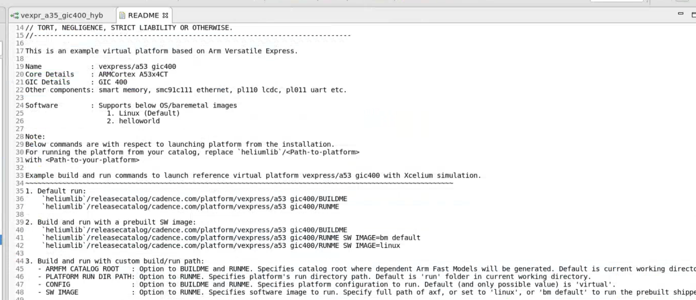
Running a Helium Example platforms – command line
Model & Platform Management
Platform Editor
Memory Map Editor
Run & Debug
Helium Example platforms can be run from the command line
Each example platform ships with a README file which details the supported command line interface. Simply copy and paste the commands out of the README to use the platform
Helium Example platforms README
Get an overview of the platform
Easy to copy customized commands
RUNME script takes custom image files and other user options
You may also use the RUNME scripts to launch into Helium SW Debug

Slide 16
ARM Fast Models in Helium
Models & Platform Management

Slide 17
ARM Fast Models in Helium
Model & Platform Management
Platform Editor
Memory Map Editor
Run & Debug
ARM Fast Model Integration is highly automated in Helium
ARM Fast Models can be easily added to the list of available models in Helium Platform Assembly to instantiate and use like a native SystemC model.
Helium natively integrates with ARM Fast Models to provide native Helium Software Debug on ARM cores.
New ARM Fast Model releases are integrated and validated at regular intervals
Helium enables ease of ARM Fast Model version upgrades for models being used with Helium
ARM Fast Models can be browsed, selected and added to the Helium Model Catalog through the ARM Fast Model wizard in Platform Assembly.
Advanced users can also use the command line utility cpuwrap to the generate the model
In future releases, the same integration will be extended to other families of processor and other IP models e.g. RISC V

Slide 18
ARM Fast Models in Helium
Model & Platform Management
Platform Editor
Memory Map Editor
Run & Debug
To support version independence and because they are updated frequently, ARM Fast Models and artifacts are not shipped with Helium.
To ensure consistency, all ARM Fast Models added to the Helium model catalog and all instances of these models in a platform must use the same ARM Fast Models release. This requirement is enforced in Helium tools.
Advanced users of ARM Fast Models can create composite ARM models that connect ARM IP directly in the LISA files. Managing and updating these models has special considerations (which is documented in the Helium Virtual and Hybrid Studio User Guide).
See the Generating ARM-Based Custom EVS Models section

Slide 19
ARM Fast Models in Platform Assembly
Model & Platform Management
Platform Editor
Memory Map Editor
Run & Debug
In Helium Platform Assembly, there are several ways to bring in ARM Fast Models
Add an existing catalog that contains previously generated ARM Fast Models using the Add Catalog capability of the Catalog Browser:
Prepare exactly those Arm Fast Models needed by a specific platform. To do this, open a new copy of the platform and follow the prompts
Helium will offer to generate the ARM Fast Models in a new catalog or in an existing catalog. If the models already exist in the existing catalog, they will be used from there instead of being regenerated.
Interactively add ARM Fast Models IP using Add Arm Fast Models Wizard
Advanced users can use the command line utility cpuwrap to generate Arm Fast Models

Slide 20
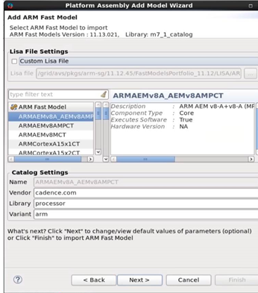
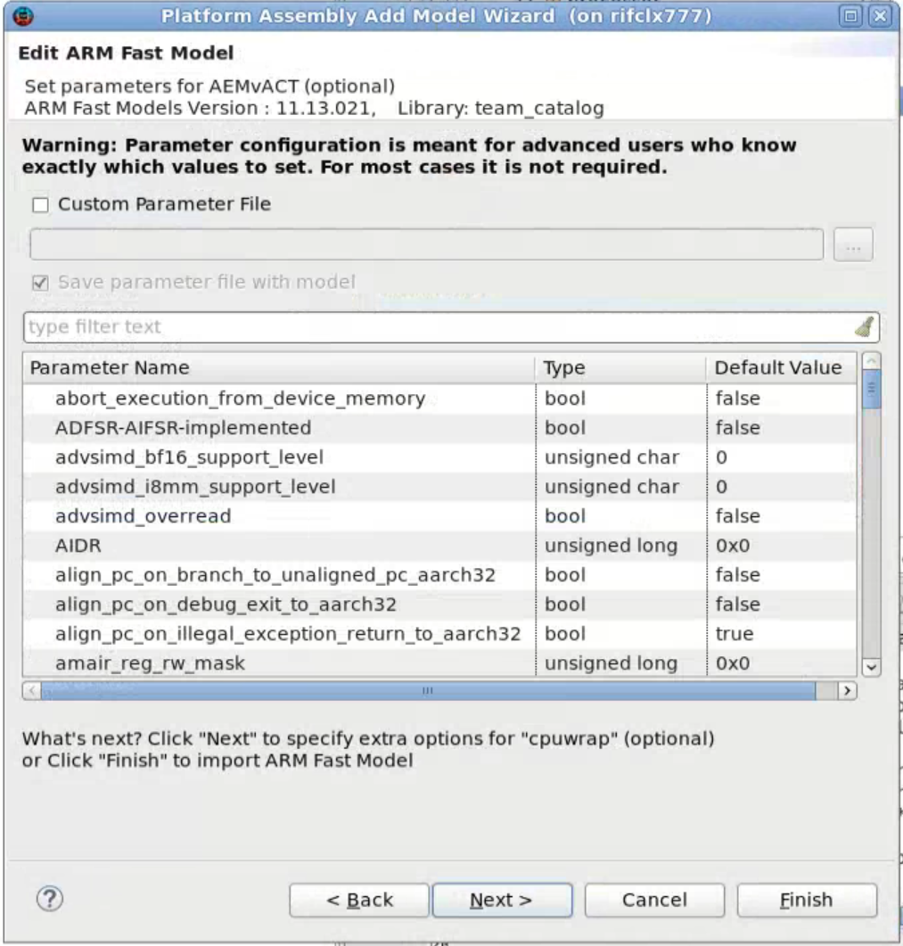
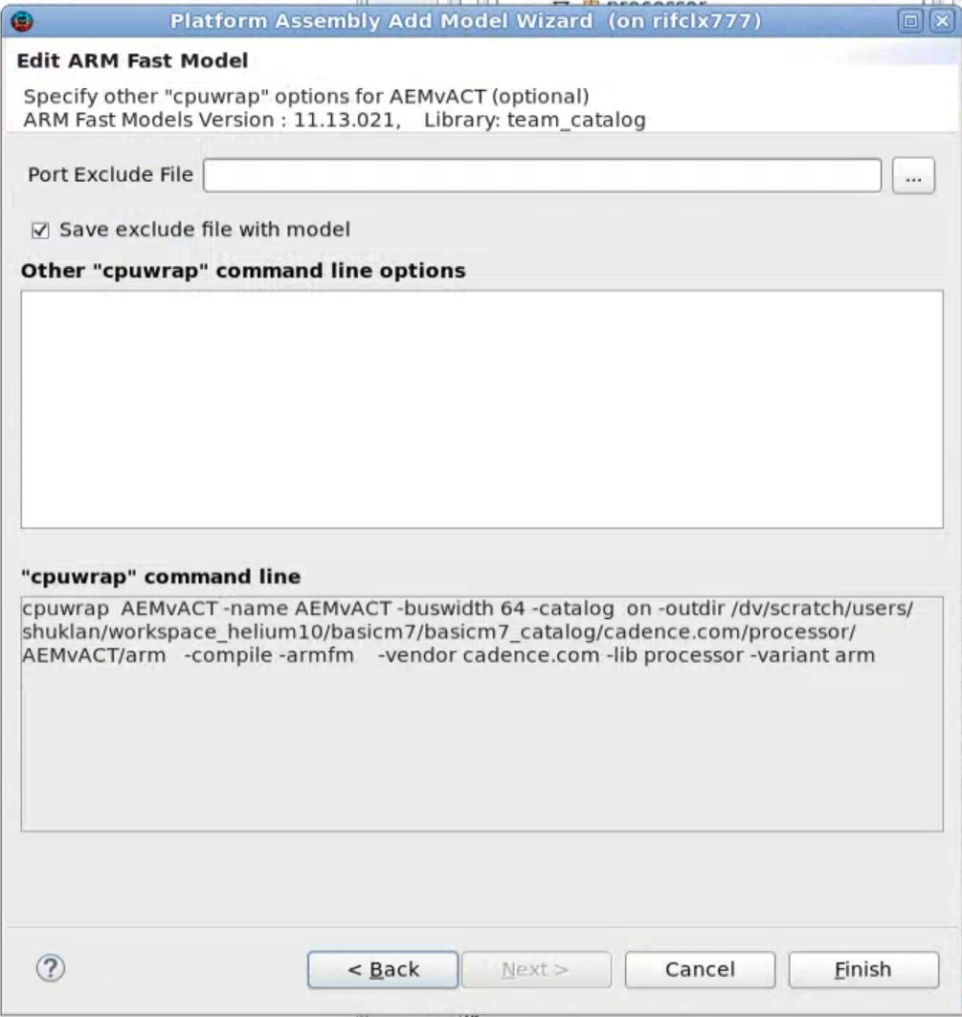
Add ARM Fast Models Wizard
Model & Platform Management
Platform Editor
Memory Map Editor
Run & Debug
Use Custom LISA file option to manually select the LISA file
Select the model to add
Easily browse released ARM Fast Models from your installation.
Optionally set default parameter values or exclude ports by specifying an exclude file
On Finish, the model is generated in your catalog
Specify custom parameter file
Specify custom port exclusion file and extra options

Slide 21
Add ARM Fast Models Wizard – advanced options
Model & Platform Management
Platform Editor
Memory Map Editor
Run & Debug
Parameter value overrides should be made in consultation with ARM Fast Models documentation that explains how to configure IP settings.
If you have many parameter value overrides, instead of entering values in the wizard, they can be added to a text file and passed with custom parameter file option in the parameters page or using –param <filename> to cpuwrap in the extra options wizard page.
Port exclude file can be specified in the final page where other cpuwrap command line options can be specified.
The text file should have one port per line to exclude
An example of excluded ports for the ARMCortexA75x4CT model:
sci_m, pchannel_core[0-3], pchannel_cluster, cti[0-3], cntvalueb
One reason to exclude ports is to exclude interfaces to a particular model (i.e., exclude those capabilities that won't be used). Unfortunately, this may not be known up-front. Sometimes ports must be excluded to get elaboration to succeed, based on the model, and in some cases the only way to figure that out is to try and see if it fails.
Other reasons to exclude ports would be: to simplify the model, to gain performance, and to remove protocols unsupported by Helium.
Models imported using the wizard can be built from the command line since a Makefile is saved during model generation

Slide 22
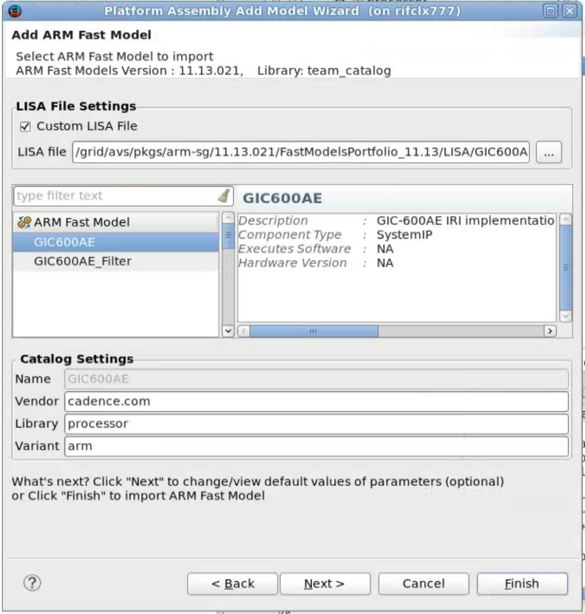
Adding Beta ARM Fast Models or “Add-on” Models
Model & Platform Management
Platform Editor
Memory Map Editor
Run & Debug
In each ARM Fast Models release, ARM includes its released models in the main package.
Models at a beta stage are not included in the main package, but LISA files for beta models are sometimes available for download from Arm.
Because only released models can be discovered using ARM Fast Models tools, beta models do not appear in the Helium ARM Fast Models wizard models list
Beta models can be added to the Helium Catalogs using the custom LISA file option in the ARM Fast Model import wizard
Beta models can also be prepared with command line tools to be brought into Helium Platform Assembly​.
Specify a BETA model LISA file
Select the model from the list of models in the LISA file

Slide 23
Adding Beta ARM Fast Models to Helium catalogs - command line
Model & Platform Management
Platform Editor
Memory Map Editor
Run & Debug
Generating Beta models:
You don’t need to close Helium for adding Beta models to a catalog
Add to any existing catalog created in Platform Assembly. Make sure you know the catalog directory (root), the location of the beta model’s lisa file in the ARM Fast Models installation, and make sure you are using the same version used to create the rest of the directory.
Create VLNV directories manually .e.g., cadence.com/processor/ARMCortexA53x4CT/arm
Copy cadence.com/makefile to cadence.com/processor/makefile and to cadence.com/ARMCortexA53x4CT/makefile
Copy `heliumlib`/mk/template/common.armfm.mk to cadence.com/processor/ARMCortexA53x4CT/arm/makefile
Edit this makefile and add:
UNIT := ARMCortexA53x4CT
There are VLNV variables. Update those
Remove any other unused variables
% make lib
% make import
Finally, click the Refresh button in the Catalog Browser to see the new model.

Slide 24
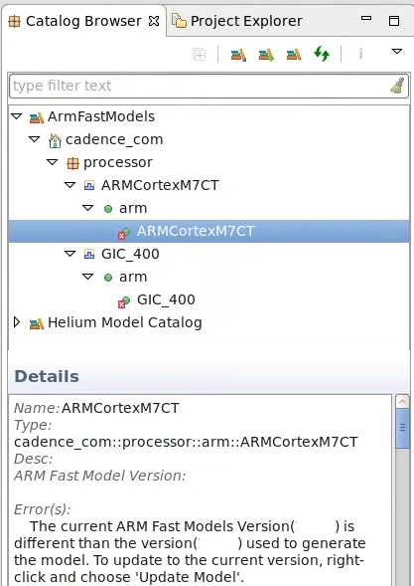
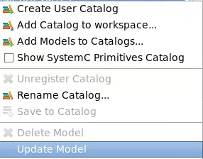
ARM Fast Models Version Changes
Model & Platform Management
Platform Editor
Memory Map Editor
Run & Debug
Helium enforces a single Arm Fast Models version for instances in a platform.
For models in catalogs built with older Arm Fast Models versions, a red “x” appears next to the model in the Catalog Browser.
Use “Update Model” to update it to the version of Arm Fast Models in the current environment.

Slide 25
Assembling Platforms
Platform Editor

Slide 26
Assemble Platforms from Building Blocks
Model & Platform Management
Platform Editor
Memory Map Editor
Run & Debug
Start from an existing Cadence example or reference platform
Features for Assembling Platforms
Instantiate model instances and delete unnecessary instances
Add items to the memory map and configure address ranges
Configure instances by setting parameter values
Make connections
Configure software images
Running Platform Checks
Creating a Platform Report
Build and Run the Platform without leaving Platform Assembly
Save the Platform back to a Catalog
Customizing the Makefile and running from the command line

Slide 27
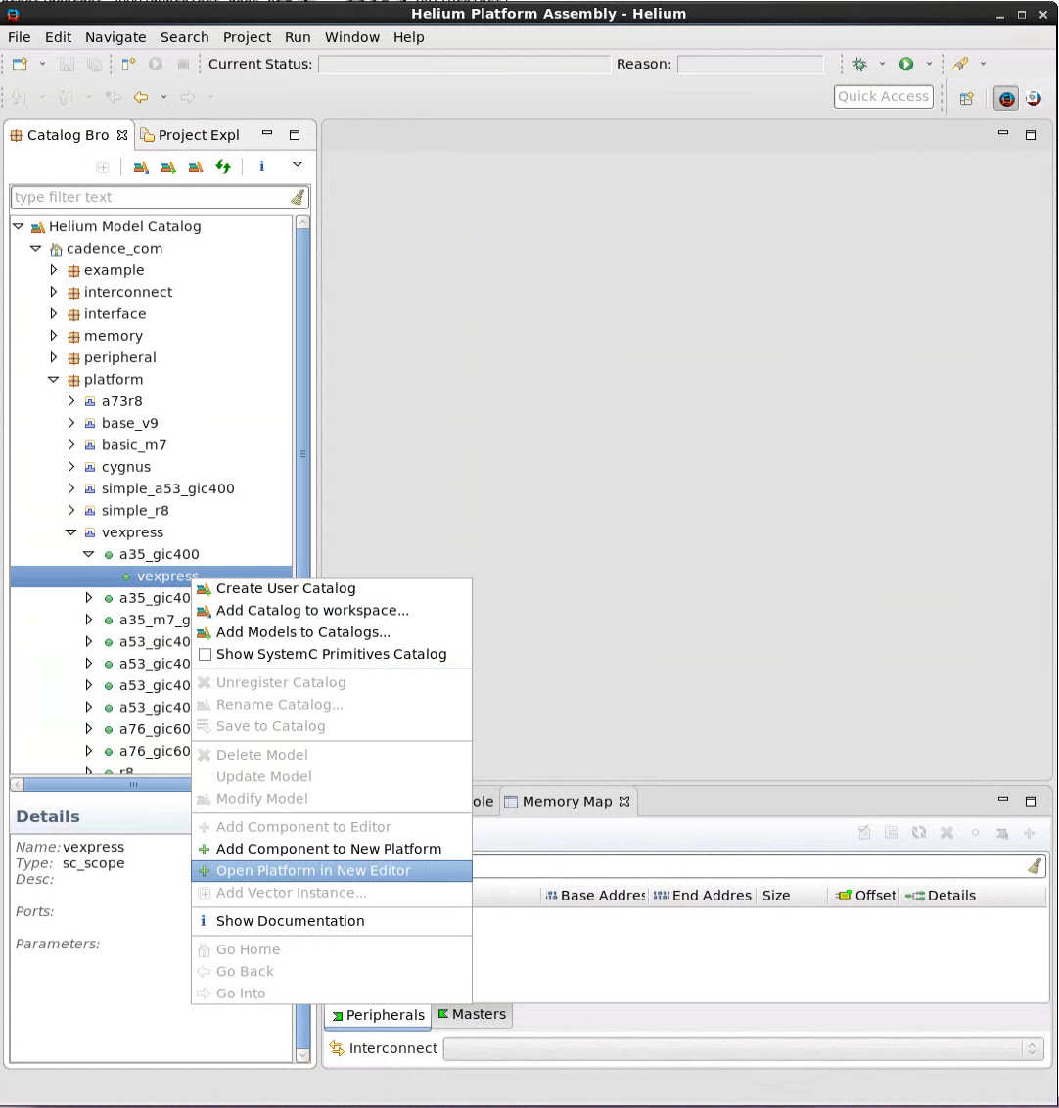
Get Started: Create a new platform starting with existing one
Model & Platform Management
Platform Editor
Memory Map Editor
Run & Debug
Choose Starter Platform
Gather Models
Assemble Platform
Save to Catalog
Start by choosing from a robust collection of Helium reference and starter platforms (virtual and hybrid) that most closely fits the desired processor/GIC/OS combination
Helium reference platforms can also be instantiated as subsystems to build up complex platforms
See vexpress_a35_m7 example

Slide 28
Gather Models
Model & Platform Management
Platform Editor
Memory Map Editor
Run & Debug
Choose Starter Platform
Gather Models
Assemble Platform
Save to Catalog
The Helium Model Catalog contains a library of commonly used building blocks for virtual and hybrid platforms
Add your own catalogs of models
Add a catalog of ARM Fast Models or add individual models using the Add ARM Fast Models Wizard

Slide 29
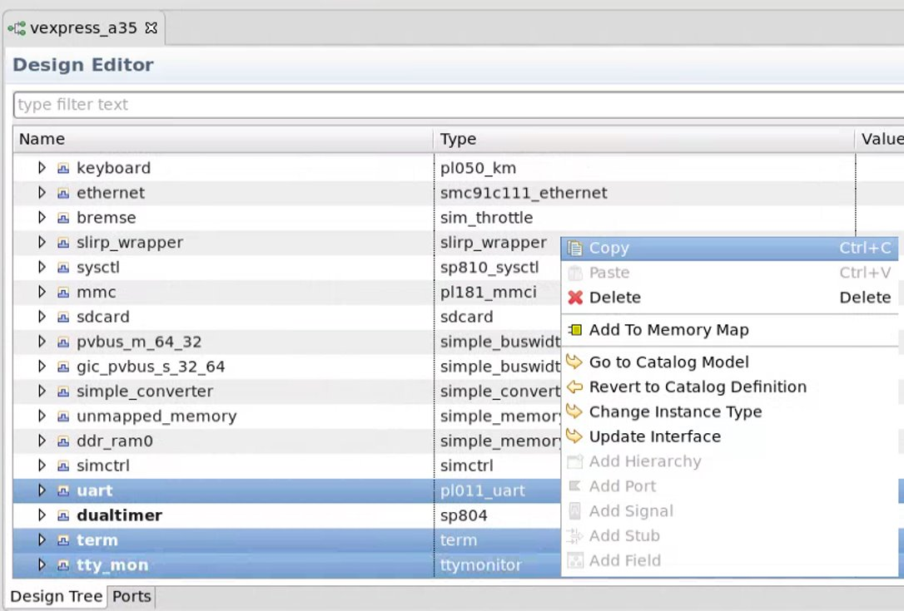
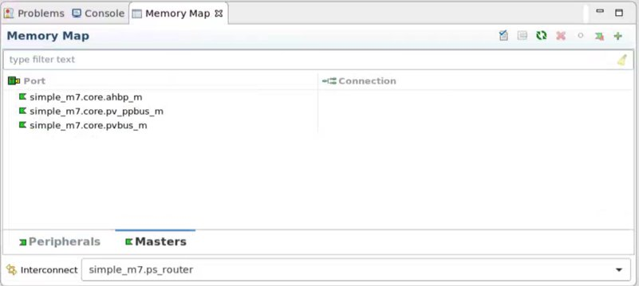
Assemble Platform
Model & Platform Management
Platform Editor
Memory Map Editor
Run & Debug
Choose Starter Platform
Gather Models
Assemble Platform
Save to Catalog
Adjust the platform by exchanging existing processor, GIC, and other instances with models from Helium Model Catalog and other added catalogs
Use “Change Instance Type” which preserves parameter settings and connections to match old instance
Remove model instances that aren’t needed
Continue with the assembly process by adding instances and subsystems, configuring parameters, memory maps, and IRQ instances, making port connections, checking for problems, and configuring software

Slide 30
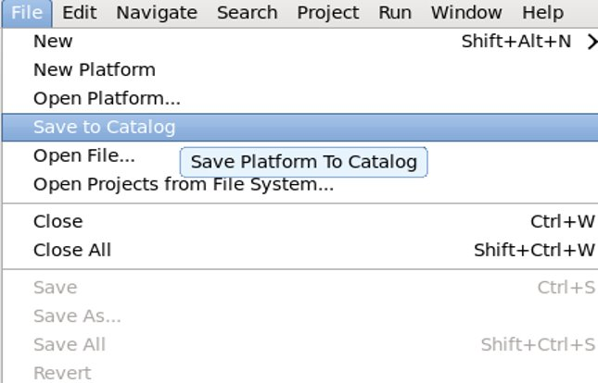
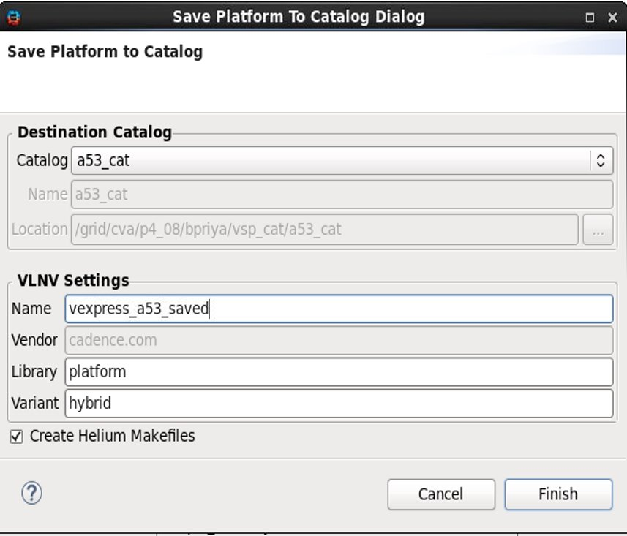
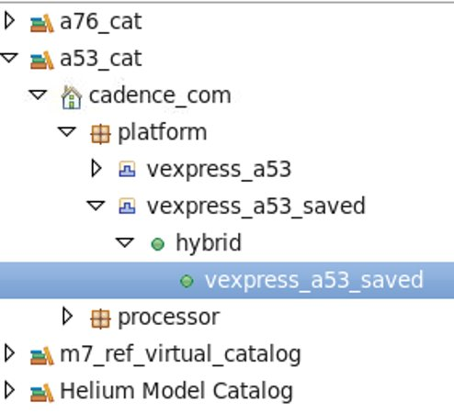
Save to Catalog
Model & Platform Management
Platform Editor
Memory Map Editor
Run & Debug
Choose Starter Platform
Gather Models
Assemble Platform
Save to Catalog
When complete, save the platform to a catalog for use outside of Helium Platform assembly and sharing with others
To debug embedded software, launch into the Helium Software Debug Perspective
See the Helium Virtual and Hybrid Studio User Guide for more information on building and running saved platforms outside of Platform Assembly

Slide 31
Instantiating models
Platform Editor

Slide 32
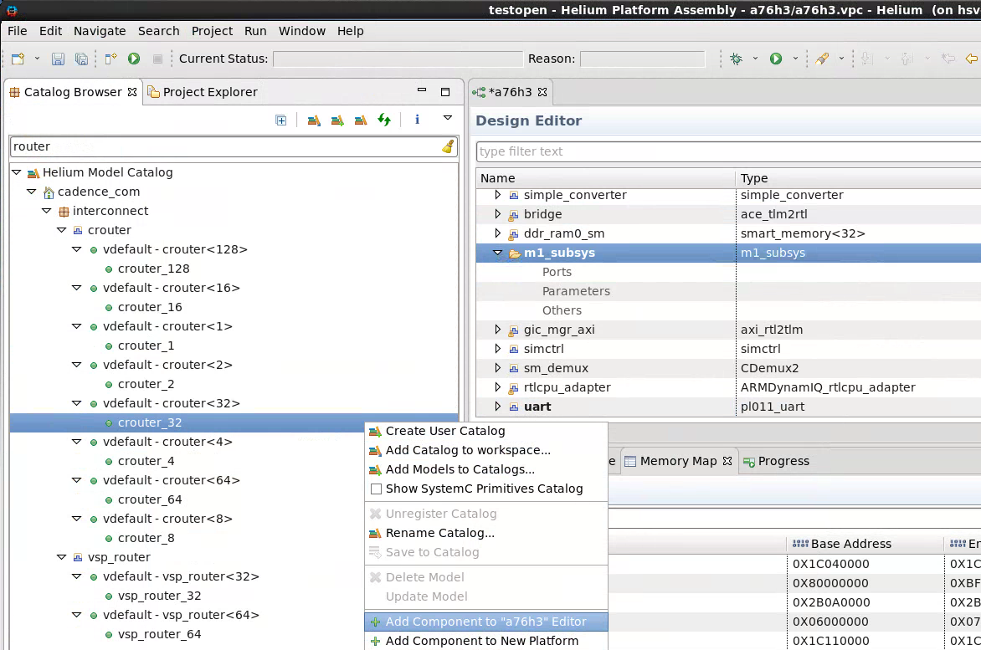
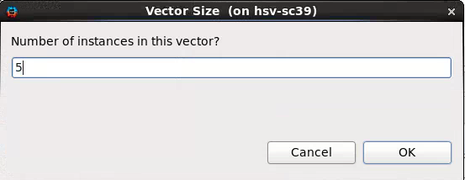
Adding model Instances to a platform in Helium is easy
Model & Platform Management
Platform Editor
Memory Map Editor
Run & Debug
Simply find the model you want and double-click.
Use “Add Vector Instance” to create an sc_vector of instances
Double-clicking on a platform will open it, but to instantiate it as a subsystem instance use the context menu to add it as a component.
Instantiate crouter instance from Helium Model Catalog in m1_subsys scope of a76h3 platform

Slide 33

Copy and paste with connections also creates new instances
Model & Platform Management
Platform Editor
Memory Map Editor
Run & Debug
When you want to save work by re-using groups of connected instances from other platforms, simply copy a group of connected instances and paste them into your platform
No need to redo connections between components and set parameter values – they get copied with the group
Make sure to make any required port connections from ports in the group to external instances
Select the uart, term, tty_mon instances in the design editor, right-click and choose Copy ​or use <Ctrl-C>
To create a new instance of the selected components, choose a platform in an open editor, select the appropriate scope, right-click and choose Paste or use <Ctrl-V>

Slide 34
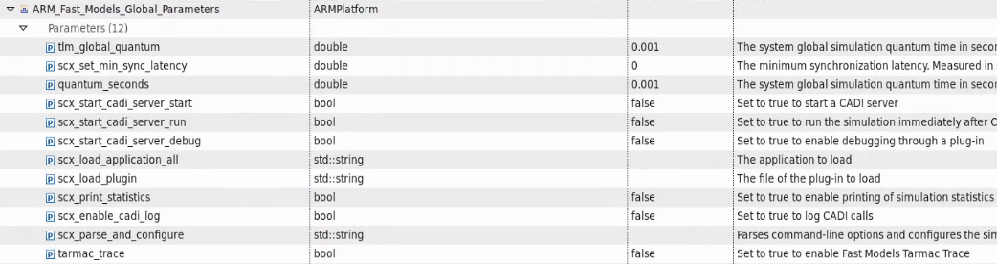
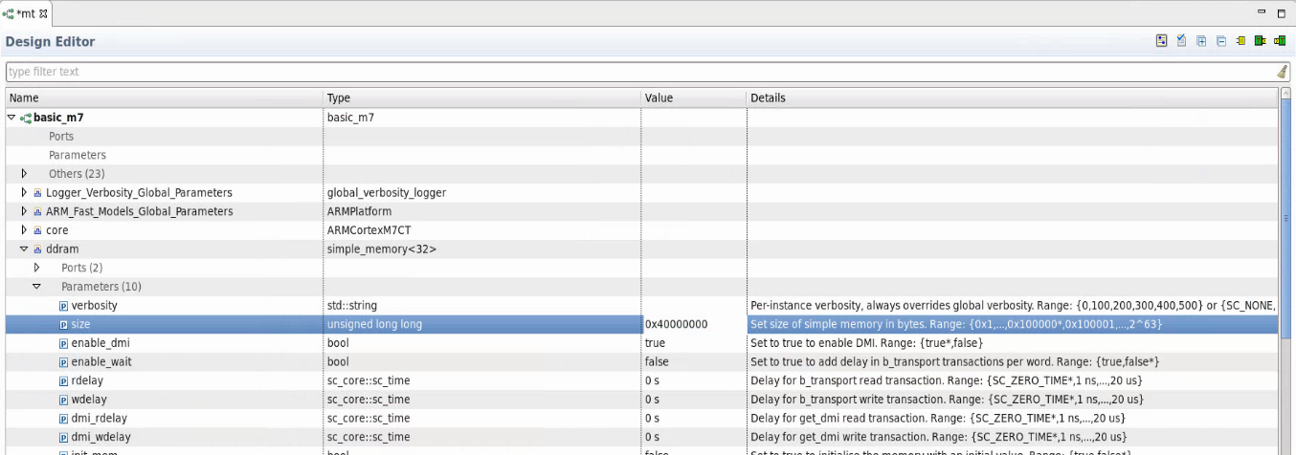

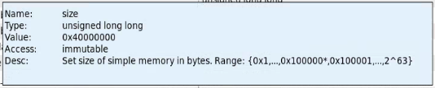
Working with Parameters
Model & Platform Management
Platform Editor
Memory Map Editor
Run & Debug
Visualize platform instance parameters and easily configure their values
View parameter documentation provided by model creators
Platform Assembly Design Editor
Global parameters common to all ARM Fast Model instances
View and edit individual model instance parameters
Use Update Interface to reconfigure instance when you change parameters that affect model interface

Slide 35
Binding Model Ports
Platform Editor

Slide 36
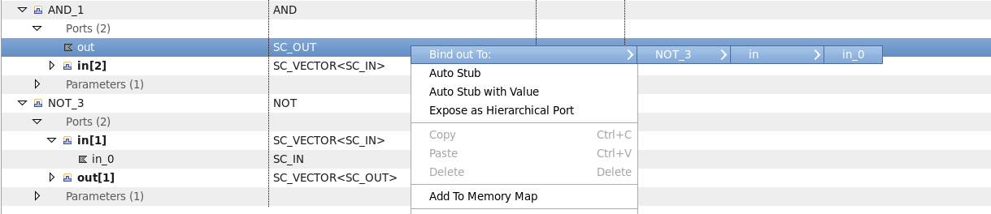
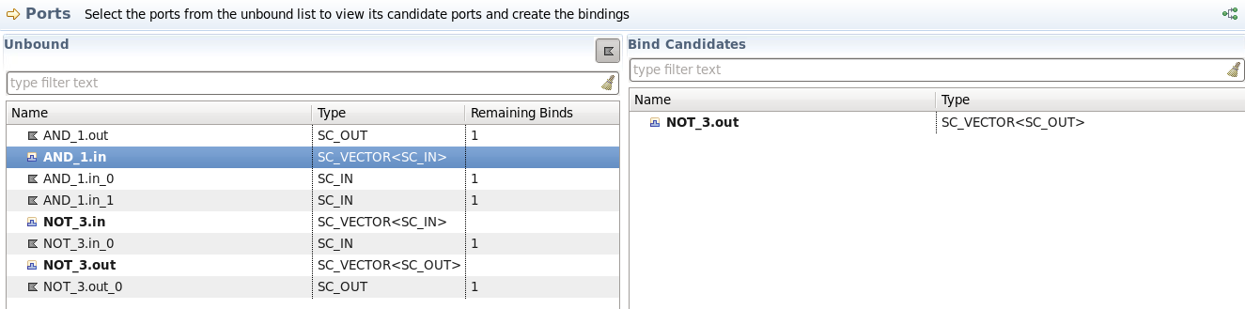
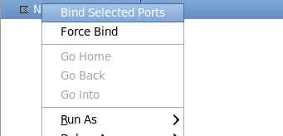
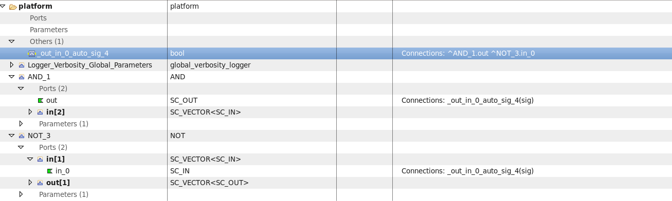
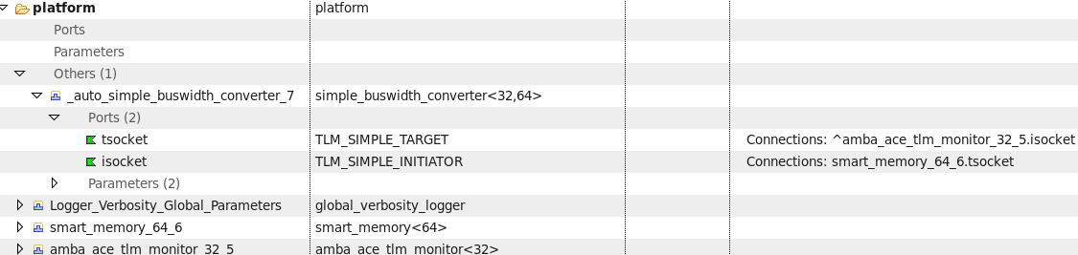
Port binding capabilities in Helium Platform Assembly
Model & Platform Management
Platform Editor
Memory Map Editor
Run & Debug
Helium Platform Assembly provides following features to enable port bindings while assembling a platform
View bind candidates for selected port as per SystemC semantics to do the binding
Auto insert required intermediate objects like signals, bus-width converters
Auto-stub ports as per SystemC semantics
Auto-stub ports with Value
Expose a port as hierarchical port
Vector Binding
Unbind ports
These actions can be done in both Design Browser or using the Ports tab
Bind candidates are available in Design Tree and Ports View for port binding
On bindings ports, intermediate objects like signals, bus-width converters etc. are auto-inserted as per SystemC semantics

Slide 37
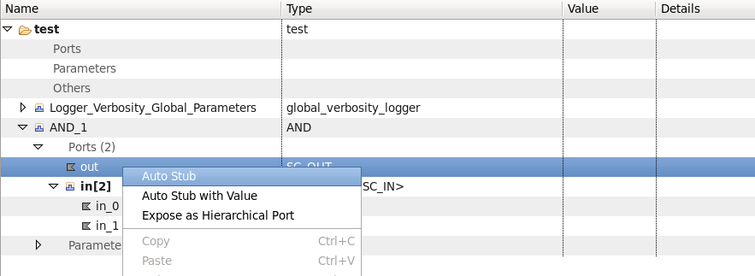
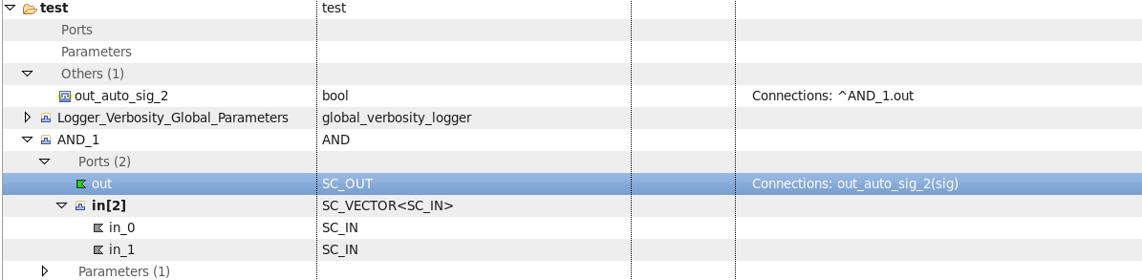
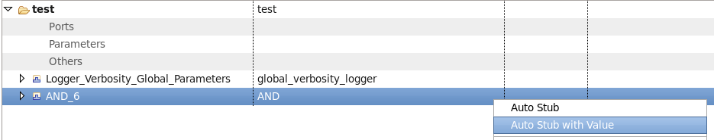
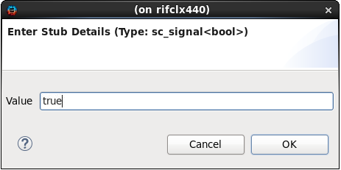
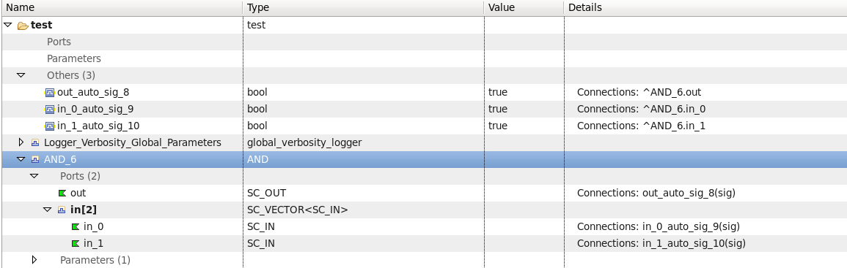
Auto-stubbing Ports
Model & Platform Management
Platform Editor
Memory Map Editor
Run & Debug
Auto Stub
Select “Auto Stub” option to stub unused ports.
Stub object is created as per SystemC symantics
Auto Stub with Value
Select “Auto Stub with Value” option to stub unused ports with an initial value
Provide initial value
Stub objects are created and initialized with specified value

Slide 38
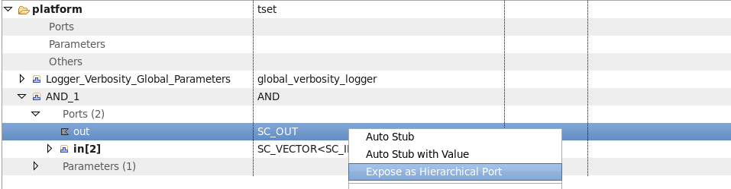
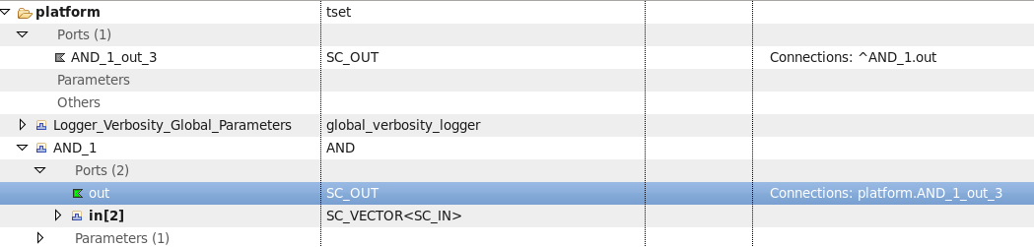
Creating Hierarchical Ports
Model & Platform Management
Platform Editor
Memory Map Editor
Run & Debug
Expose as Hierarchical Port
Select “Expose as Hierarchical Port” option to expose a port as hierarchical port
Hierarchical port is created as per SystemC semantics

Slide 39
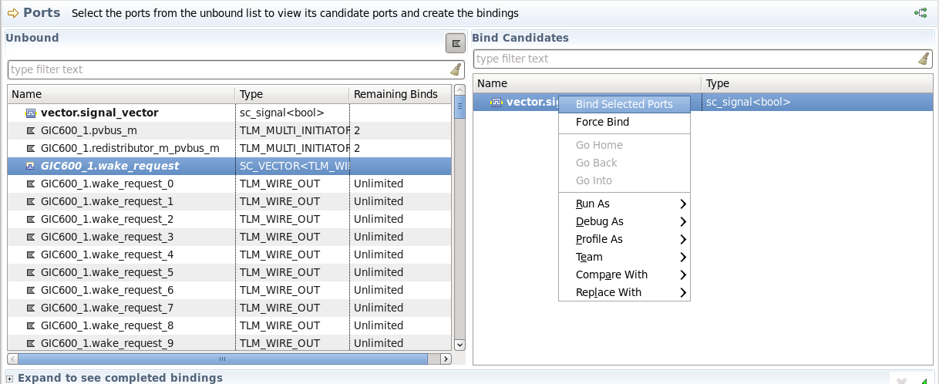
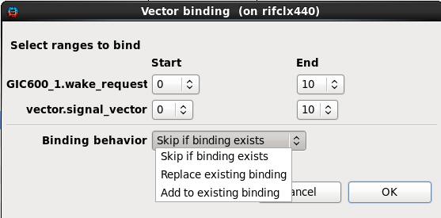
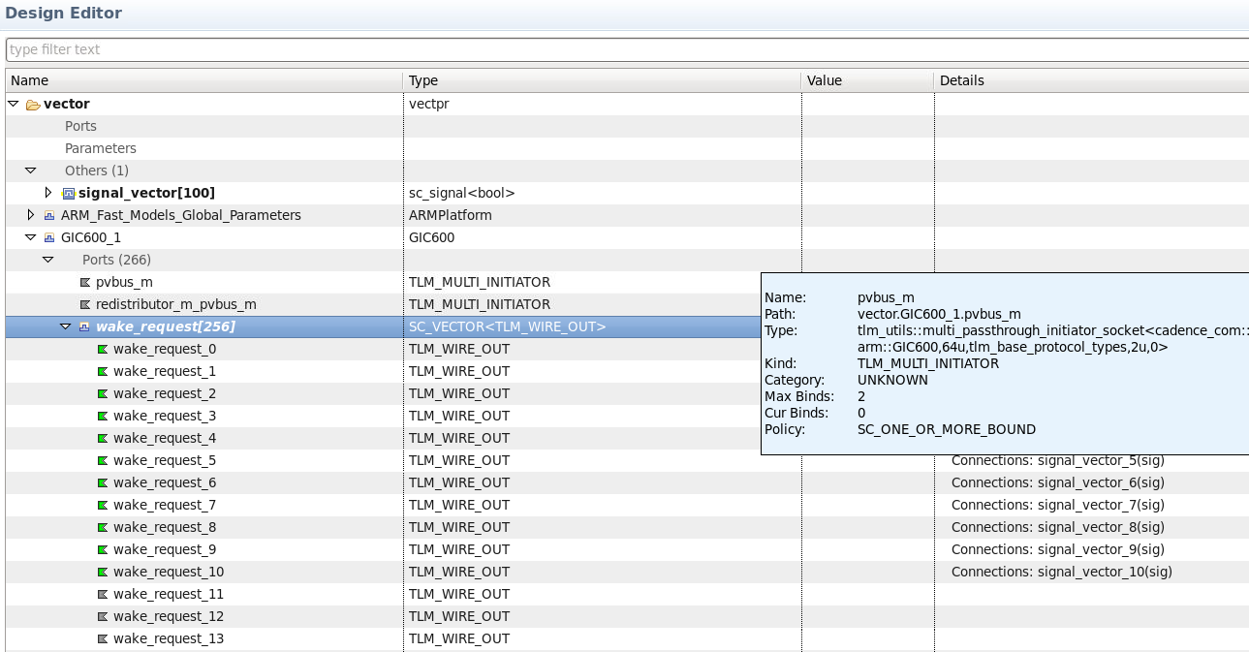
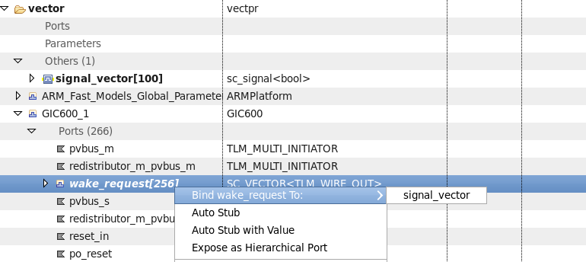
Binding Vector Ports
Model & Platform Management
Platform Editor
Memory Map Editor
Run & Debug
Vector Binding
Select a vector from available bind candidates in Design Tree and Ports View
Binding is done for ports in the selected range
Select range for vector binding
Select behavior for existing binding

Slide 40
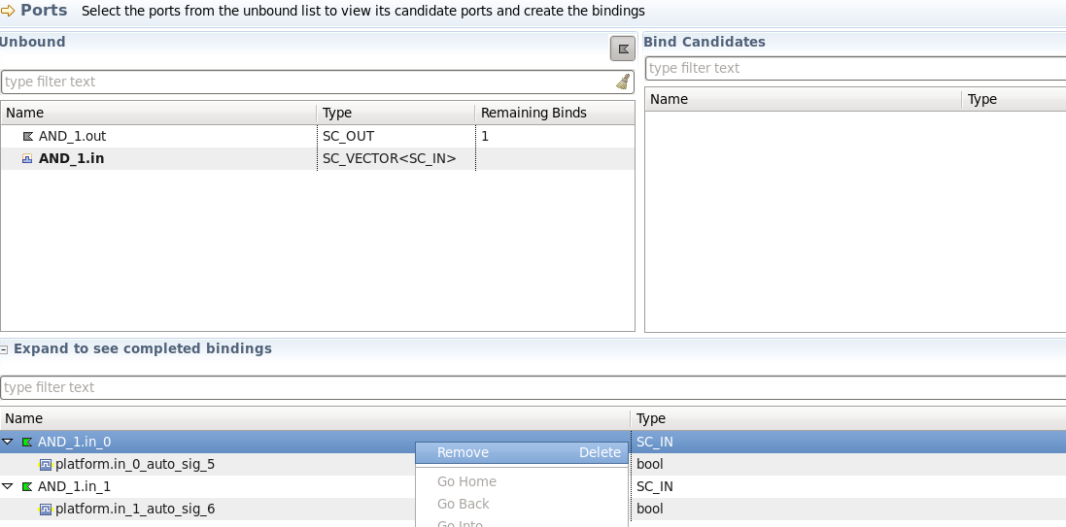
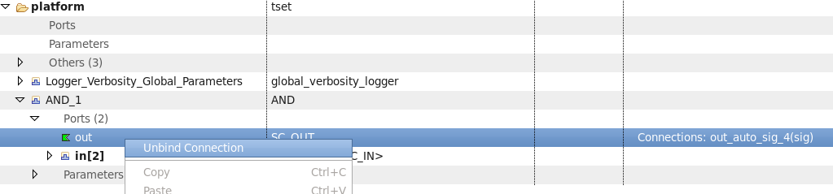
Unbinding Ports
Model & Platform Management
Platform Editor
Memory Map Editor
Run & Debug
Unbind Ports
Select these options to remove existing bindings for a port

Slide 41
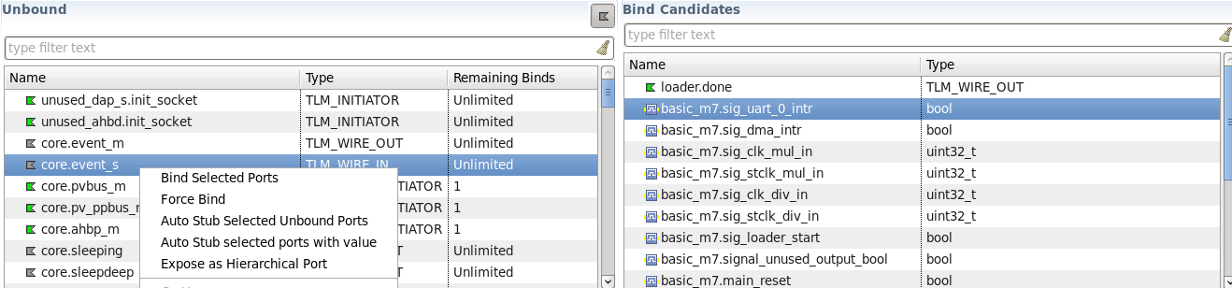
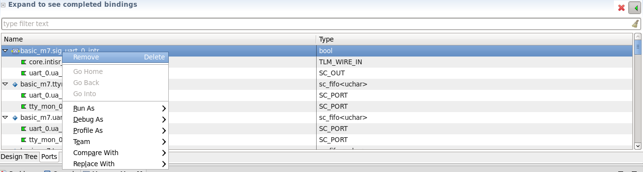
Ports View
Model & Platform Management
Platform Editor
Memory Map Editor
Run & Debug
This section contains list of ports/signals ports that a selected available port in “Unbound” section can be bound to.
Ports tab in the Design Editor is a specialized view to perform port binding operations.
In this view, only port information is present in editor area to facilitate port binding operations efficiently.
This section contains list of ports/signals that can be bound
All port binding operations are available in context menu
Filtering is available in each section to narrow down the set of displayed items
This section contains list of ports/signals that have already been bound.
Unbind operation is available in this section
This option can be used to show reverse bindings, which shows list of slave ports and the master ports that are connected to them

Slide 42
Working with Memory Maps
Memory Map Editor

Slide 43
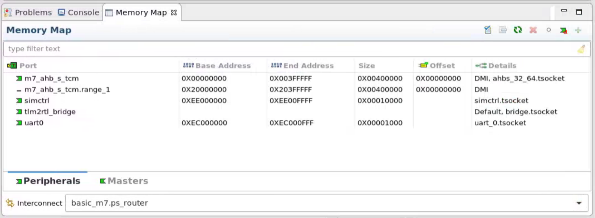
Working with memory maps in Helium Platform Assembly
Model & Platform Management
Platform Editor
Memory Map Editor
Run & Debug
Overview
Visualize and Edit Memory Map using Memory Map View​
System Memory Map presented in an easy-to-understand view​
Memory Map creation is eased by automatic entry creation and automatic connections when using the Cadence router (to be extended to other routers in future versions)
Use Memory Map Checks to validate entries and find common errors

Slide 44
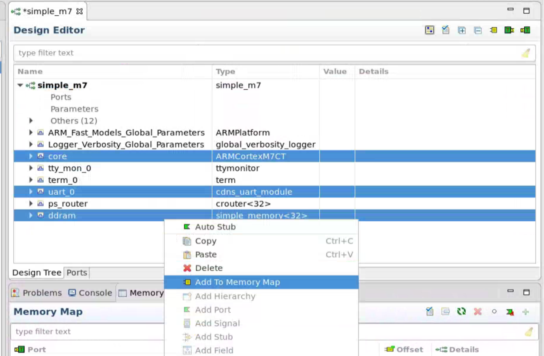
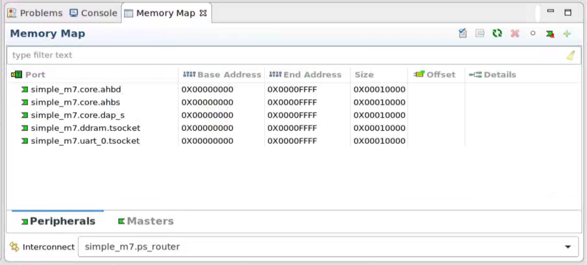
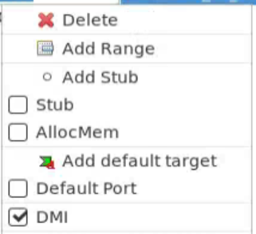
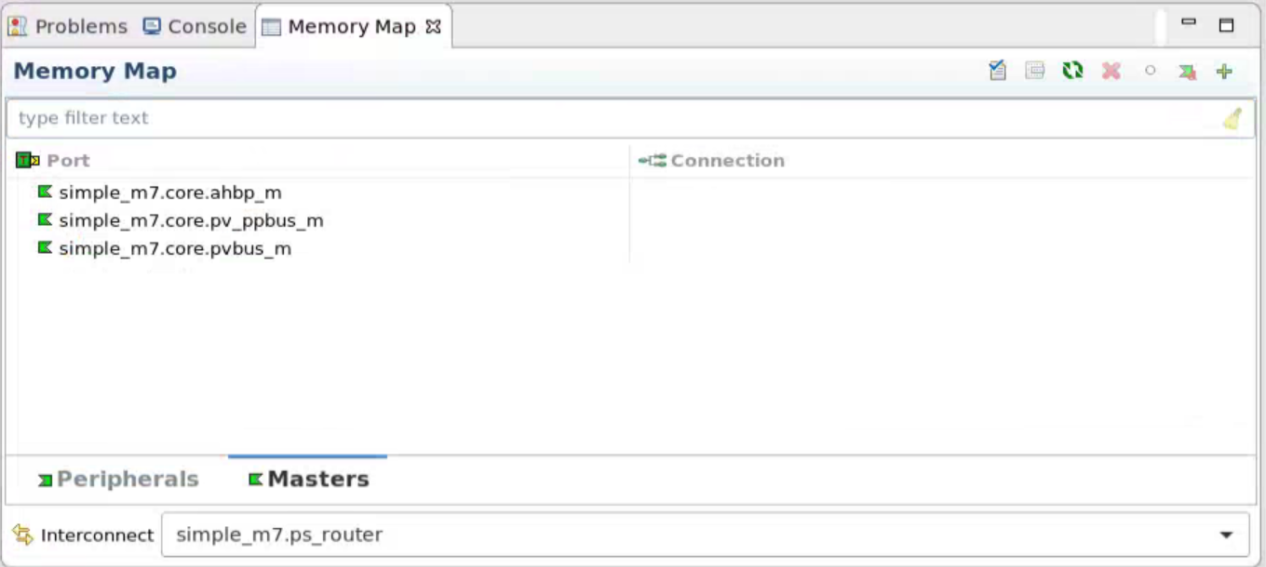
Creating a memory map
Model & Platform Management
Platform Editor
Memory Map Editor
Run & Debug
Add to Memory Map action
Instantiate the crouter model to seed a memory map in the platform
Easily add to memory map by multi-select of instances (initiators/targets) and ports
“Validate” runs the Memory map rules checker
Reconfigure generates the actual connections between router, targets and initiators
Use in table editing to customize the address range for a peripheral
You can edit start, end, size and offset fields. Fields are recalculated based on edits.
Sub-ranges can be added for a selected entry using the “Add Range” action.
Default target can be added using the “Add Default Target” button or context menu.
Other attributes of an entry can be modified using the context menu e.g. “DMI”, “Stub” and “AllocMem”
Reconfigure and Connect to easily make necessary connections

Slide 45
Working with Subsystems
Platform Editor

Slide 46
Working with Subsystems in Helium Platform Assembly
Model & Platform Management
Platform Editor
Memory Map Editor
Run & Debug
Assemble a subsystem in Platform Assembly
Subsystem has all the same considerations as a platform
Assemble subsystem exactly like a platform
Additional Considerations
Design the interface of the subsystem
Hierarchical Ports
Hierarchical Memory Map

Slide 47
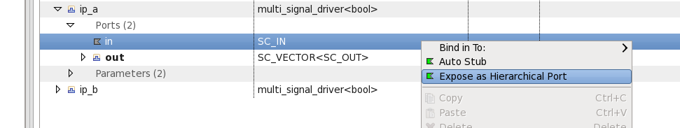
Create and Bind Subsystem Hierarchical Ports
Model & Platform Management
Platform Editor
Memory Map Editor
Run & Debug
SystemC Methodology
Create hierarchical port at subsystem interface of right type
Bind hierarchical port to child model's port inside subsystem
Platform Assembly abstracts the complexity with built-in SystemC port-binding rules checker
Simplifies hierarchical port binding
Right click model's port, select 'Expose as Hierarchical Port'
Hierarchical port appears at subsystem interface, with correct type and binding

Slide 48

Create and Bind Subsystem Hierarchical Ports (cont...)
Model & Platform Management
Platform Editor
Memory Map Editor
Run & Debug
Use Case: Bind hierarchical subsystem port to multiple ports inside the subsystem
Example: create subsystem reset input port feeding into reset input ports of multiple child models inside the subsystem
Right click any one child model's reset port, select 'Export as Hierarchical Port'
Subsystem port will get created and hierarchically bound to this child model's reset port
Right click subsystem port, bind it to remaining child models' reset ports
One-to-many multiple bindings are created for the subsystem port
Advanced user can create subsystem port directly at subsystem interface
Right click subsystem, select 'Add Port' menu selection
Bind subsystem port like any other port, guided by Platform Assembly SystemC Rules Guide

Slide 49

Hierarchical Memory Map: Internal Master Addresses External Peripherals
Model & Platform Management
Platform Editor
Memory Map Editor
Run & Debug
Master inside subsystem addresses external peripherals
In m7_subsystem below, we want the m7 core to be able to address peripherals external to the subsystem, in addition to the local peripherals inside the subsystem

Slide 50


Hierarchical Memory Map: Internal Master Addresses External Peripherals
Model & Platform Management
Platform Editor
Memory Map Editor
Run & Debug
Construct subsystem memory map as usual, and select the interconnect to which the master of interest is connected
Click on the Peripherals tab at the bottom, and click on the 'Add default target' button on the top right
A new default port entry appears in the memory map. You can rename the port instance to 'default_port'. All addresses that do not route to local peripherals inside the subsystem will be routed to this default port. Reconfigure the memory map.

Slide 51

Hierarchical Memory Map: Internal Master Addresses External Peripherals
Model & Platform Management
Platform Editor
Memory Map Editor
Run & Debug
Go to the selected interconnect in the Design Editor, expand the ports, and select the 'default_port' from the 'master' port list
Right click and select 'Expose as Hierarchical Port'

Slide 52

Hierarchical Memory Map: Internal Master Addresses External Peripherals
Model & Platform Management
Platform Editor
Memory Map Editor
Run & Debug
The default port is propagated to the subsystem boundary
Effectively, the internal master is now exposed at the subsystem boundary, and can participate in any routing inside the parent of the subsystem

Slide 53

Hierarchical Memory Map: External Master Addresses Internal Peripherals
Model & Platform Management
Platform Editor
Memory Map Editor
Run & Debug
External master outside the subsystem addresses peripherals inside the subsystem
In a35_subsystem below, we want two external masters to address peripherals inside the subsystem

Slide 54


Hierarchical Memory Map: External Master Addresses Internal Peripherals
Model & Platform Management
Platform Editor
Memory Map Editor
Run & Debug
Construct subsystem memory map as usual, and select the interconnect that will route to the internal peripherals of interest
Click on the Maters tab at the bottom, and click on the 'Add initiator' button on the top right
A new port entry appears in the memory map. You can rename the port instance to 'external_master_port_1'. Reconfigure the memory map

Slide 55

Hierarchical Memory Map: External Master Addresses Internal Peripherals
Model & Platform Management
Platform Editor
Memory Map Editor
Run & Debug
Go to the selected interconnect in the Design Editor, expand the ports, and select 'external_master_port_1' from the 'slave' port list
Right click and select 'Expose as Hierarchical Port'

Slide 56

Hierarchical Memory Map: External Master Addresses Internal Peripherals
Model & Platform Management
Platform Editor
Memory Map Editor
Run & Debug
The port for the external master is propagated to the subsystem boundary
Effectively, an external master can now address inside the subsystem, using this subsystem interface port
For additional external masters, you can similarly add additional entries to the memory map in the Masters tab, and expose as subsystem ports

Slide 57


Save Subsystem to Catalog
Model & Platform Management
Platform Editor
Memory Map Editor
Run & Debug
To instantiate and reuse your subsystem in other platforms, save it to a VLNV catalog
Create a new catalog, or select existing catalog, fill in VLNV location details inside catalog

Slide 58

Instantiate Subsystem in a Platform
Model & Platform Management
Platform Editor
Memory Map Editor
Run & Debug
In top level platform, browse to saved subsystem in catalog, and double click the subsystem to instantiate it
The subsystem is copied out into the platform on instantiation
Any changes done to the original subsystem subsequently are not reflected in the platform, and vice versa
Child subsystem port inside the platform behave like any other child model port, and can be bound or added to platform memory map as usual

Slide 59
Checking for Errors
Platform Editor

Slide 60

Platform checks in Helium Platform Assembly
Model & Platform Management
Platform Editor
Memory Map Editor
Run & Debug
“Check For Problems” Action runs platform checks on the platform
Use Platform Checks to validate the platform for problems before elaboration/simulation
Problem description helps in identifying the root cause of problem
Navigation through problems view helps to quickly identify instances having problem
Examples of Platform Checks are Catalog Definition Check, Interface Update Check, Port Unbound Check, Catalog ARM Fast Models Version Check etc.
Error/Warning details are present in instance tooltip
Instance with problem is highlighted in Design Editor
Problems with details can be viewed in Problems View. Double-clicking a problem highlights instance for which problem is reported.

Slide 61


Platform Reports
Model & Platform Management
Platform Editor
Memory Map Editor
Run & Debug
Helium is designed to help create platforms that are correct by construction.
Debugging problems in the assembly should be done within Helium.
Sometimes a report in textual format can be useful to summarize key information about the platform such as its instances, parameters, ports and connections.
The report can serve as a “manifest” of platform contents.
Choose between text and comma separated values
Content sections of the report are configurable

Slide 62
Building and Running Platforms
Run & Debug

Slide 63
Build and Run from Platform Assembly
Model & Platform Management
Platform Editor
Memory Map Editor
Run & Debug
Overview
While assembling a platform, Platform Assembly allows you to elaborate and run without ever leaving the tool
Use “Project -> Build Platform” when you want to verify that the platform elaborates successfully without running it
Use “Run ->Run Platform” to perform a quick test to see if the platform launches or to launch into Simvision to debug SystemC models
Create a Helium “Debug Configuration” to launch into Helium Software Debug to debug embedded software

Slide 64





Elaborate and Run platforms
Model & Platform Management
Platform Editor
Memory Map Editor
Run & Debug
Customize the elaboration options before building
Elaborate platforms without running
Quickly verify that a platform can run by “building” the platform. This will elaborate the platform without running it.
Customize Elaboration options before building.
Customize platform launch and run platforms.
Optionally connect to SimVision upon launch.
SystemC models should be built for debug using –g option to g++ for use with SimVision
Build Platform and check for elaboration errors prior to launching
Run Platform launches the platform
Customize the run options.
Optionally connect to SimVision
“Terminate” button ends simulation

Slide 65
Saving Platforms to Catalogs & working with Makefiles
Models & Platform Management

Slide 66



Saving Platform and Makefiles to User Catalog
Model & Platform Management
Platform Editor
Memory Map Editor
Run & Debug
Overview
Changes to an existing platform, or newly created platforms can be saved to a VLNV Catalog
​User has the option to save generated makefiles alongside the Platform to build and run the platform from command line
​All model dependencies are recorded and managed by the makefile

Slide 67
Saving makefiles
Model & Platform Management
Platform Editor
Memory Map Editor
Run & Debug
Platform built from scratch, or edited from existing platform in Platform Assembly can be saved to VLNV catalog
Helium makefiles are created and saved at the platform VLNV. Option provided to skip saving makefiles
Makefiles are different between hybrid and virtual platforms, heuristic used to deduce hybrid platform from hybrid adapter usage
Saved makefiles are fully interoperable with Helium catalog build framework
Platform is checked for errors before saving, and user is warned about any errors
When platform is saved for the first time, empty README file is saved, and mk/custom_options.mk file is created
Saving platform multiple times overwrites the previously saved makefiles, except custom_options.mk
Ensures platform always stays in sync with Helium catalog build framework, but retaining any customizations done in custom_options.mk
From command line, use makefie to build or run the platform
Saved platform can be opened back in Platform Assembly for round trip flow
Any customizations done to makefiles are not read back
For hybrid platforms, three configurations are saved similar to reference platforms
On reopening platform from saved VLNV, user gets same RTL awareness as reference platforms, e.g., allowing specification of RTL snapshot path
Meta data associated with platform (e.g., image or tcl file) is not managed by Platform Assembly, and not saved to catalog. Needs to be manually copied by user.

Slide 68

Makefile Hierarchy
Model & Platform Management
Platform Editor
Memory Map Editor
Run & Debug
Mapping of logical catalog name to physical path
Platform Assembly entry point. User entry point with simple high-level targets, and few knobs to control behavior. Also has fine grained, detailed targets and many variables for advanced user. Includes platform specific makefiles inside mk directory
boilerplate
List of all models
RTL specific content
platform specific
Run related content

Slide 69
Makefile Hierarchy
Model & Platform Management
Platform Editor
Memory Map Editor
Run & Debug
Makefile Targets
lib: Build dependent Fast Models and import them. For hybrid platform, build RTL design
build_armfm: Build dependent Fast Models and import them​
build_rtl: Build RTL design​
pre_elab: For hybrid platform, link run dir with RTL design lib, generate files needed for elab and run
elab: Elaborate the platform​
run: Run the platform​
clean: Clean all built dependencies and platform run​
clean_armfm_deps: Clean built Fast Models​
clean_rtl_build (only hybrid): Clean built RTL design​
clean_run: Clean platform run
Makefile Variables
CONFIG​ (configuration of platform: virtual, hybrid-xcelium, hybrid-palladium, hybrid-protium. Value should be in sync with build_configs file content)
RTL_SNAPSHOT_PATH (Output location of RTL design build)​
PLATFORM_RUN_DIR_PATH​ (Output location of platform run)​
USR_ELAB_ARGS​ (Elaboration arguments)​
RUN_ARGS​ (Run time arguments)​
USR_RUN_ARGS (Additional run time arguments)
TCL_FILE​ (tcl file input)​
SW_DEBUG (Whether to launch tcl prompt for interactive ESW debug)
XEDEBUG (Enable/Disable xeDebug)
NBRUN_INTERVAL (interval for nbrun)

Slide 70


Saving Run Options and Elab Options
Model & Platform Management
Platform Editor
Memory Map Editor
Run & Debug
Platform->’Configure Platform Build Options’ is saved in makefile as USR_ELAB_ARGS variable
Run->’Configure Run Options’ is saved in makefile as RUN_ARGS variable
Platform Options to select options to pass to the platform makefile. This is only shown when there is an underlying Helium makefile in the platform
Provide path to the custom RTL

Slide 71
Command Line Usage
Model & Platform Management
Platform Editor
Memory Map Editor
Run & Debug
Build dependent ARM FM models $>make build_armfm
Run platform as is $>make run
Change run arguments and run, e.g., input tcl file, or image $>make run RUN_ARGS=‘-f my_args.f’
Build RTL design for hybrid platforms $> make build_rtl RTL_DESIGN_SOURCE_PATH=<path> RTL_SNAPSHOT_PATH=<path>
Change nbrun interval for hybrid z1 mode $>make run NBRUN_INTERVAL=1ns
In the hybrid platforms, choose Palladium or Protium or Xcelium $> make build_rtl RTL_DESIGN_SOURCE_PATH=<path> RTL_SNAPSHOT_PATH=<path> CONFIG=hybrid-protium $> make clean_run run RTL_SNAPSHOT_PATH=<path> CONFIG=hybrid-protium
*Note – Based on RTL, some platforms may not have all three configurations

Slide 72
Makefile variables and catalog.map
Model & Platform Management
Platform Editor
Memory Map Editor
Run & Debug
Following makefile variables available for fine grained control of reference platform sw are not available for saved platforms, need to override entire RUN_ARGS
SW_IMAGE, ESW_CONFIG, ESW_CONFIG_DIR, CUSTOM_IMAGE_PATH
Following makefile variables can be customized from custom_options.mk
NBRUN_INTERVAL, RTL_DESIGN_SOURCE_PATH, RTL_DESIGN_BUILD_ARGS, RUN_ARGS RUN_ARGS = '-f run.f'
Following makefile variables can be overridden only from command line
CONFIG, RTL_SNAPSHOT_PATH, PLATFORM_RUN_DIR_PATH, TCL_FILE, USR_ELAB_ARGS, USR_RUN_ARGS, SW_DEBUG, XEDEBUG, ESW_CONFIG_FILE
catalog.map file is saved at platform VLNV. Contains logical name of catalog followed by physical path. Each line represents one catalog
Physical catalog path can use environment variable or be absolute path

Slide 73
Refresh and Update Platforms
Models & Platform Management

Slide 74
Summary of Refresh and Update Process
Model & Platform Management
Platform Editor
Memory Map Editor
Run & Debug
Refresh and update a platform
When an underlying model changes
To a new version of ARM Fast Models
To a new version of the tool

Slide 75
How Helium Handles Model Updates
Model & Platform Management
Platform Editor
Memory Map Editor
Run & Debug
Assemble platform in Helium Platform Assembly
Subsequently, model author updates one of the platform models
Helium Platform Assembly detects model interface change and enables easy update of platform to get updated model interface

Slide 76


Model & Platform Management
Platform Editor
Memory Map Editor
Run & Debug
1. Platform has an instance multiplexer_1
Model author updates name of isocket to initsocket.
Model is built again with this change in the same catalog. (Outside Helium Platform Assembly)
2. Helium Platform Assembly detects an update in model’s shared object
3. Problem details are present in tooltip & Problems View

Slide 77



Model & Platform Management
Platform Editor
Memory Map Editor
Run & Debug
4. Select “Go to Catalog Model” option in Design Tree View
5. Model is selected in Catalog Browser
7. Select “Update Model” option to regenerate interface
6. “Details” section shows warning for model’s shared object update

Slide 78



Model & Platform Management
Platform Editor
Memory Map Editor
Run & Debug
8. After successful model update, Helium Platform Assembly detects an update in model’s interface & highlights the instance with details in the tooltip & Problems View
9. Select “Update Interface” option in Design Tree View
10. Interface update is reflected for model instance in platform. Helium Platform Assembly preserves instance bindings for ports which are not updated.

Slide 79
How Helium Handles ARM Fast Model Version Updates
Model & Platform Management
Platform Editor
Memory Map Editor
Run & Debug
Platform is created with a certain ARM Fast Models© version
Helium Platform Assembly is launched with a different ARM Fast Models© version
Helium Platform Assembly detects ARM Fast Models© version change, prompts to update model & platform to new ARM Fast Models© version

Slide 80



Model & Platform Management
Platform Editor
Memory Map Editor
Run & Debug
1. Platform has ARMCortexM7CT instance named ARMCortexM7CT_1. Current ARM Fast Models© version is 11.10
3. Select “Go to Catalog Model” option in Design Tree View
2. Helium Platform Assembly is launched with ARM Fast Models version 11.11. Helium Platform Assembly detects change in ARM Fast Models© version and highlights the instance with details in the tooltip & Problems View

Slide 81


Model & Platform Management
Platform Editor
Memory Map Editor
Run & Debug
4. Model is selected in Catalog Browser
5. “Details” section shows an error for ARM Fast Models© version change
6. Select “Update Model”

Slide 82


Model & Platform Management
Platform Editor
Memory Map Editor
Run & Debug
7. Helium Platform Assembly regenerates the model by invoking cpuwrap with ARM Fast Models© version 11.11. Output is shown in the console and user can see update in the Progress view
8. Once update is complete, model is updated to ARM Fast Models© version 11.11 and platform instance has no error

Slide 83
The Helium Catalog Framework
Models & Platform Management

Slide 84
Helium Catalog Framework
Model & Platform Management
Platform Editor
Memory Map Editor
Run & Debug
Organization of Models, Platforms, IPs
Directory structure – VLNV
Build framework – makefiles with convenient targets, utility scripts
Management of software images for starter and reference platforms
Enabling mix and match of model libraries from multiple users
Methodology for Adding and Managing Model and Platform Lifecycles
Streamlines integration with 3rd Party Models and IPs e.g., ARM FM, Imperas,..
Interoperability with the Helium Product
Sharing platforms

Slide 85
Helium Catalog Framework Overview
Model & Platform Management
Platform Editor
Memory Map Editor
Run & Debug
Helium catalog shipped with Helium
Located at `heliumlib`/releasecatalog
Multiple catalogs will be shipped eventually
Organized into VLNV directory structure
Widely adopted in the industry, e.g., OVP follows same organization
V – vendor (cadence.com)
L – library (peripheral)
N – name (cdns_uart)
V – version (vdefault)
Robust methodology to create models using VLNV structure integrated with tlmgen and cpuwrap
Sophisticated makefile framework to compile, elaborate, run platforms, and much more
Enable mix and match of models from multiple catalogs in a single platform
Utility scripts to assist users with local catalog creation and updates
Seamless integration with third party models e.g., ARM Fast Models

Slide 86
Integration with third party IPs, seamless platform update flows
Model & Platform Management
Platform Editor
Memory Map Editor
Run & Debug
Track model dependencies of platforms and generate ARM Fast Models on the fly in user’s workspace
Helium catalog size stays manageable
Flexibility for customers to move to new ARM FM versions
When ARM FM version changes, or tool version changes
Platform ‘make run’ tracks the dependencies, regenerates ARM Fast Models and recompiles user models

Slide 87
Standard Setup for Helium Model Catalog
Model & Platform Management
Platform Editor
Memory Map Editor
Run & Debug
No need to source various setup scripts, no need to set up any environment variables
Point to the tools (Xcelium, VXE, AVIP, MMP, etc) – that’s it! Use the catalog
heliumlib utility
heliumib points to `xmroot`/tools/esl/modelcatalogs
heliumlib is also a wrapper to call the catalog utilities create_catalog, create_vlnv etc
helumlib create_catalog …
heliumlib create_vlnv ….

Slide 88
Running starter and example Platforms
Model & Platform Management
Platform Editor
Memory Map Editor
Run & Debug
No need to create a local catalog with a copy of the reference platform, RTL design and software
Run from any user scratch directory, pointing to reference platform in the Helium install
Customize
Catalog location for dependent ARM Fast Models generated on the fly
Build location for RTL design
cd <scratch-dir>
make –f `heliumlib`/releasecatalog/cadence.com/platform/vexpress_a35/hybrid/makefile run ARMFM_CAT = `pwd` RTL_SNAPSHOT_PATH=`pwd`
Ship dedicated bare metal SW for each platform
One default image is pre-built and shipped
Other bare metal sw shipped by Cadence can be built by user, or user’s own bare meal sw image can be specified
Executable BUILDME, RUNME scripts and README script that guides user on supported platform configurations

Slide 89
Multiple Catalog Support
Model & Platform Management
Platform Editor
Memory Map Editor
Run & Debug
User platform and Cadence platform can instantiate models from multiple Helium catalogs and multiple user catalogs
Not restricted to single Cadence catalog and single user catalog
Centralized Helium makefile infrastructure at `heliumlib`/mk used by all catalogs
No duplication of makefile infrastructure inside each catalog
Current status
`heliumlib`/releasecatalog externally shipped

Slide 90
Interoperability with Helium Platform Assembly
Model & Platform Management
Platform Editor
Memory Map Editor
Run & Debug
Helium makefile framework is fully interoperable with Platform Assembly
Platform created in Helium Platform Assembly can be saved to catalog with Helium makefiles
ARM Fast Models created in Platform Assembly save Helium makefile
Platforms and ARM Fast Models created in Platform Assembly can be executed from command line
Rebuild the platform, tracking all its model dependencies
Regenerate and rebuild the ARM FM models as necessary (e.g., when ARM FM version changes)
Elaborate and Run the platform varying run time arguments
All platform edits in Platform Assembly

Slide 91
Sharing Platforms with Multiple Users
Model & Platform Management
Platform Editor
Memory Map Editor
Run & Debug
Save the platform created using the Save to Catalog menu option in Helium
Ensure that Generate Helium Makefiles option is turned on in the wizard
The catalog.map file generated has a mapping of catalog names to directories
Edit this file to replace the directory locations with environment variables which can be set by the users of the platform
E.g., replace a line like
DEFINE ARM_FM_Catalog /some/path/to/the/arm/fm/catalog
With
DEFINE ARM_FM_Catalog ${ARM_FM_CAT_DIR}
The user of the platform can set ARM_FM_CAT_DIR and run make build in the platform directory to update the catalog registry
Create a tar of the platform directory and share it with other users
Users can untar this platform and add it to Helium by using the Add Catalogs action in the Helium catalog browser

